Slide 1
Pavan Kumar Aryasomayajulu
I work as a Software Architect at Sails Software Solutions

Slide 2
What is Elastic Search?
Elastic Search is a search engine based on Lucene
Near real time search
Some real time issues I faced with Near real time.
Distributed Elasticsearch is a distributed, open source search and analytics engine for all types of data, including textual, numerical, geospatial, structured, and unstructured. Elasticsearch is built on Apache Lucene

Slide 3
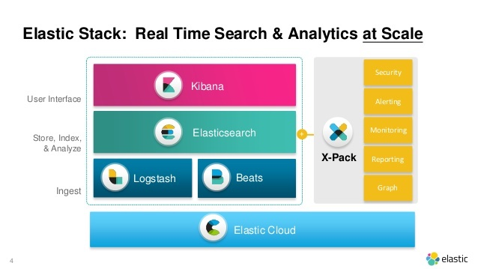
Elk Stack

Slide 4
Installing ElasticSearch Using Docker

Slide 5
Key Terminologies
Document: It is the basic component of ES. It contains data.
Index: Collection of documents
Shard is a Lucene Index which contains documents
Node: A single server which contains multiple shards
Cluster: A collections of Nodes

Slide 6
Replica Shards
Replica Shard is a copy of Primary Shard. The main reason for having a replica shard is to make sure that even if the primary shard /node is down, but still we want our application to run.

Slide 7
We are expecting to store documents related to a Q&A site. I am expecting that the overall load of my site will never exceed 50GB. My machine size is around 1TB and I gave a good amount of RAM. I am not worried even If my site is down for a certain time(even hrs) and I can restore data from somewhere or ok to loose data during downtime or ok even if the data is completely lost because of a hardware failure.

Slide 8
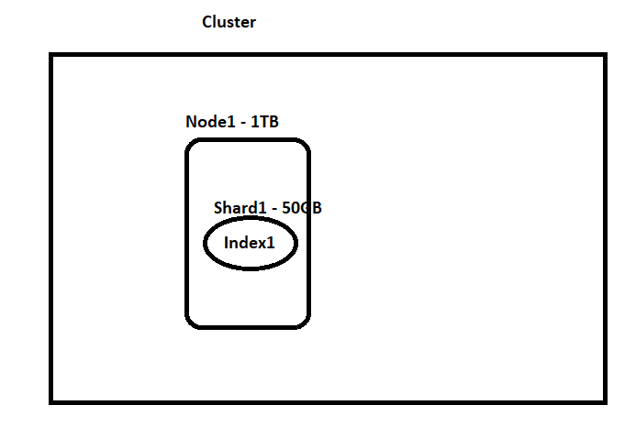

Slide 9
We are expecting to store documents related to a Q&A site. I am expecting that the overall load of my site will never exceed 50GB. My machine size is around 1TB and I gave a good amount of RAM. I am not worried even If my site is down for a certain time(even hrs) and I can restore data from the snapshot and It is ok to lose data during downtime but not complete data

Slide 10
PUT testshard { } Get _cat/indices Lets observe status of index

Slide 11
Now lets try to make index status green?

Slide 12
PUT testshard { "settings": { "number_of_replicas": 0, "number_of_shards": 1 } }

Slide 13
We are expecting to store documents related to a Q&A site. I am expecting that the overall load of my site will never exceed 50GB. My machine size is around 1TB and I gave a good amount of RAM. I want to make sure that we will not have any downtime but I am ok to take the minimal chance of downtime

Slide 14
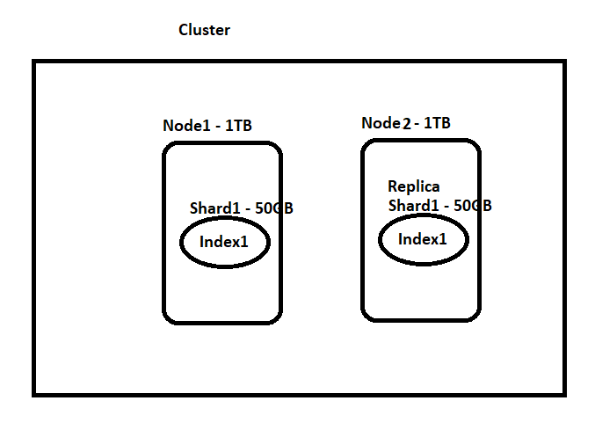

Slide 15
Show demo in Docker Playground

Slide 16
I am expecting that the overall load of my site might be around 1.5TB. My machine size is around 1TB and I gave a good amount of RAM. I want to make sure that we will not have any downtime but I am ok to take the minimal chance of downtime. — Now read below section and decide :)

Slide 17
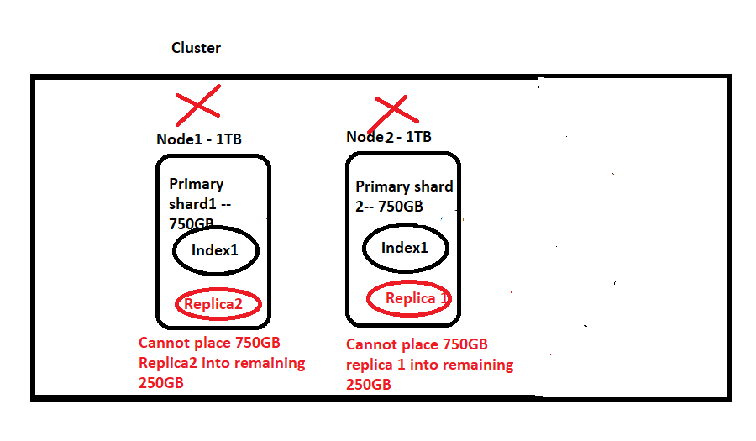

Slide 18
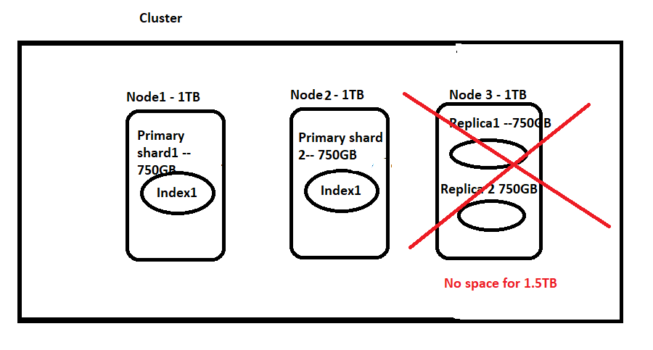

Slide 19
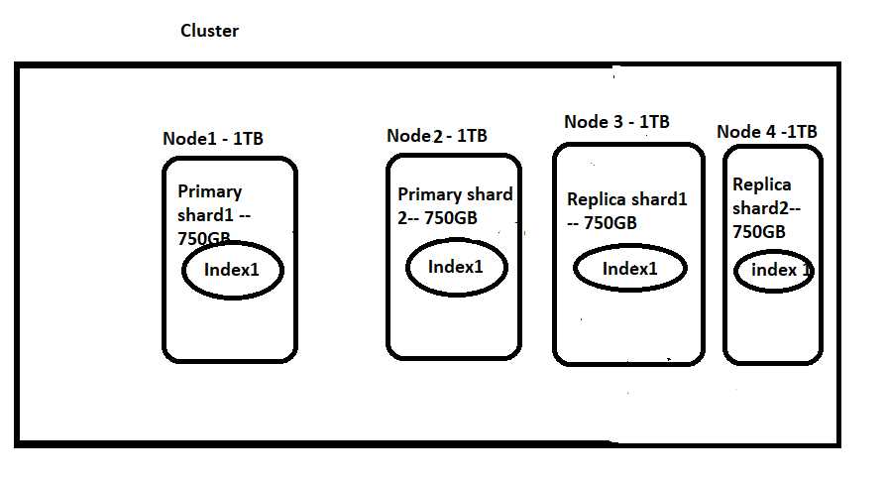

Slide 20
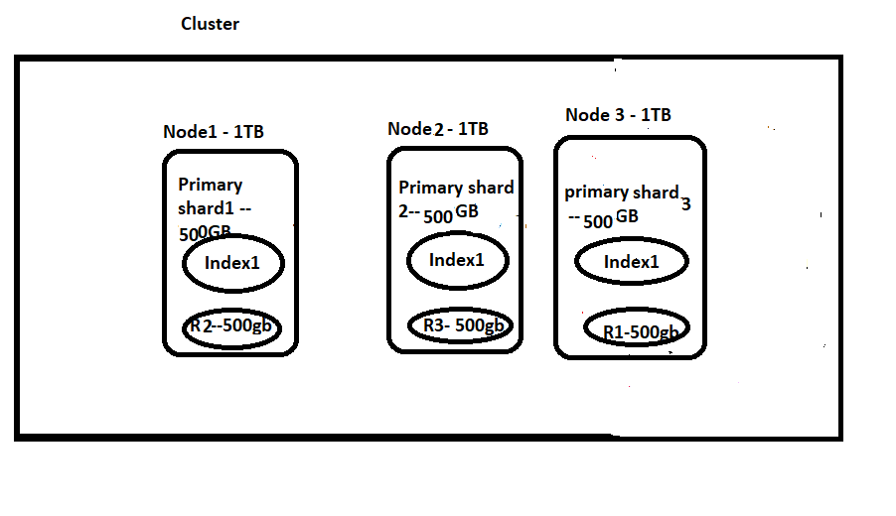

Slide 21
Index some data using Python file

Slide 22
Index Some Data Using Logstash

Slide 23
Inverted Index
Inverted Index is the primary data structure of elastic search. This data structure is the core of the search engine and makes lookup possible

Slide 24
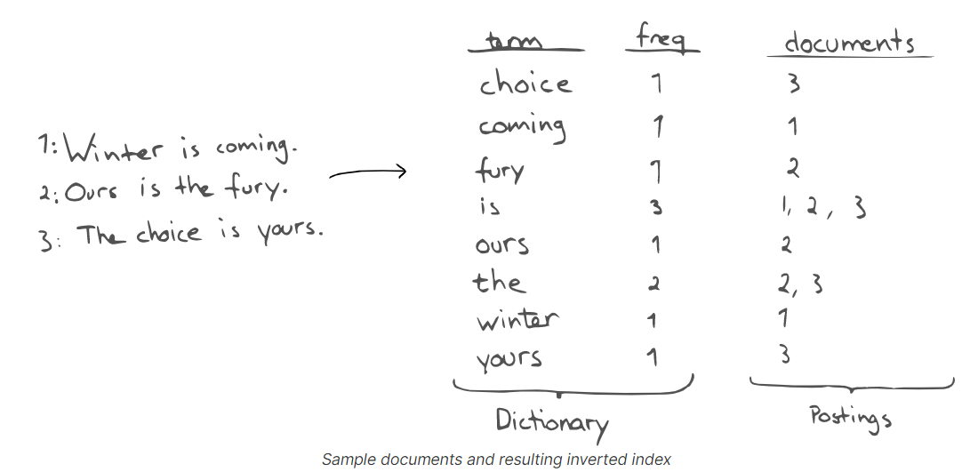

Slide 25
Lets Get Into Action
I think we are done with bulk data upload and Setup.
Now Lets try playing with ElasticSearch
AS I am from RDBMS background, I’ll try to compare Elastic search with RBDMS when ever it is possible.

Slide 26
Create Index in ES
Elastic Search (Index) | SQL Server(Table)
Sharding – It can be used to distribute data across multiple nodes in a cluster Replication can be configured at index level So we need to specify shard details and replication details at the time of index creation or else it will take default values 1 and 1 for shards and replications Schema specification is not required and It will automatically infers schema from 1st inserted record.(They can be prevented by certain settings) | 1.Fully partitioning data across multiple servers isn’t something that SQL Server does out of the box 2. Replication is done at DB level 3.It is not required to specify shard or Replication details when creating tables 4. Schema needs to be defined at the time of table creation

Slide 27
Mapping
Put stackoverflow_top/
{
"mappings":
{
"properties":
{
"field1":{
"type":"text",
"fields":{
"keyword":
{
"type":"keyword"
}
}
},
"field2":{
"type":"integer"
},
"field3":
{
"type":"float",
"index":false
}
}
}
}

Slide 28
Datatypes
String text and keyword
Numeric long, integer, short, byte, double, float, half_float, scaled_float
Date
date
Boolean boolean
Binary binary
Range integer_range, float_range, long_range, double_range, date_range, ip_range
Object object for single JSON objects
Nested
nested for arrays of JSON objects

Slide 29
Update Mappings
Put stackoverflow_top/_mappings
{
"properties":
{
"parentfield4":
{
"type":"nested",
"properties":
{
"nestedfield4_1":
{
"type":"text"
}
}
}
}
}

Slide 30
Adding Array Mapping
Put stackoverflow_top/_mappings
{
"properties": {
"parentfield5_array": {
"properties": {
"nestedfield5_1": {
"type": "text"
}
}
}
}
}

Slide 31
Why Nested Docs?
PUT my-index-000001/_doc/1 { "group" : "fans", "user" : [ { "first" : "John", "last" : "Smith" }, { "first" : "Alice", "last" : "White" } ] }

Slide 32
Fields in Mapping
Put stackoverflow_top
{
"mappings":
{
"properties":
{
"field1":
{
"type":"text",
"fields":
{
"raw":
{
"type":"keyword"
},
"whitespace":
{
"type":"text",
"analyzer":"whitespace"
}
}
}
}
}
}

Slide 33
Analyzers
Only text fields support the analyzer mapping parameter.
It is mainly used for analyzing the content we are trying to index

Slide 34
Using Stopword analyzer along with others
Put stackoverflow_top
{
"mappings": {
"properties": {
"field1": {
"type": "text",
"fields": {
"stopword": {
"type": "text",
"analyzer": "stop"
},
"raw": {
"type": "keyword"
}
}
}
}
}
}
} https://www.elastic.co/guide/en/elasticsearch/reference/6.8/analysis-analyzers.html

Slide 35
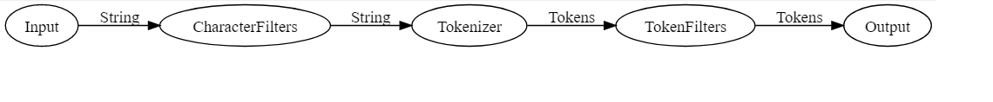
Components of an Analyzer

Slide 36
Custom Analyzer
PUT /stackoverflow_top/
{
"settings": {
"analysis": {
"analyzer": {
"customHTMLSnowball": {
"type": "custom",
"char_filter": [
"html_strip"
],
"tokenizer": "standard",
"filter": [
"lowercase",
"stop",
"snowball"
]
}
}
}
},
"mappings": {
"properties": {
"field1":
{
"type": "text",
"fields": {
"html_strip":
{
"type":"text",
"analyzer":"customHTMLSnowball"
},
"raw":
{
"type":"keyword"
}
}
}
}
}
}

Slide 37
The two <em>lazy</em> dogs, were slower than the less lazy <em>dog</em>

Slide 38
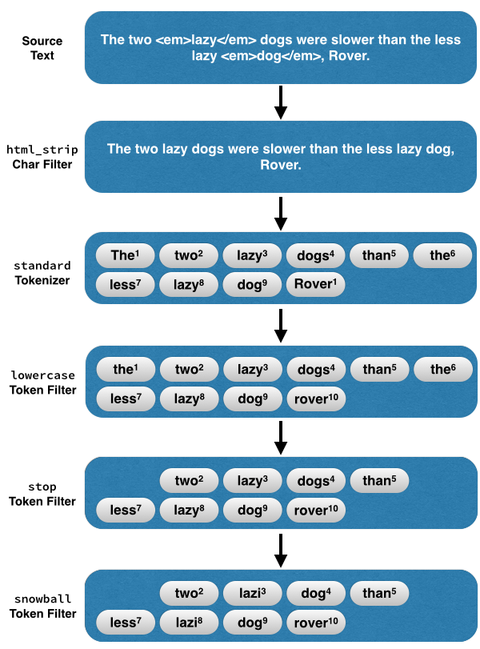

Slide 39
Stop Auto Index creation when we post data first time
PUT _cluster/settings { "persistent": { "action.auto_create_index": "false" } } Can be used to prevent auto index creations. Options for restricting dynamic mappings:
1. Globally
Set property index.mapper.dynamic: false in file elasticsearch.yml and it will apply to all indexes in the system

Slide 40
Restricting at Mapping level. This way we are making sure that we dont get unwanted fields
PUT stackoverflow_top/
{
"mappings": {
"dynamic": "strict",
"properties": {
"test": {
"properties": {
"foo": { "type": "text" },
"bar": {
"type": "nested",
"properties": {
"bell": { "type": "text" }
}
}
}
}
}
}
}

Slide 41
To make it dynamic again
PUT /stackoverflow_top/_mapping
{
"dynamic": “true"
}

Slide 42
Dynamic =false
PUT /stackoverflow_top/_mapping
{
"dynamic": “false"
} Usually these fields are not indexed and cannot be queried. Show demo on Luke

Slide 43
Demo Luke
Post <index>/_refresh

Slide 44
Flush
Flushing an index is the process of making sure that any data that is currently only stored in the transaction log is also permanently stored in the Lucene index. TransLog: Changes to Lucene are only persisted to disk during a Lucene commit, which is a relatively expensive operation and so cannot be performed after every index or delete operation. Changes that happen after one commit and before another will be removed from the index by Lucene in the event of process exit or hardware failure

Slide 45
Post <index>/_flush Now check Luke

Slide 46
Automatic Index Creation
To disable Automatic index creation we can use in elasticsearch.yml action.auto_create_index:false index.mapper.dynamic:false

Slide 47
Insert and Updating Docs

Slide 48
Versioning
Use of “version”
Use of “if_seq_no=4&if_primary_term=1” PUT test/_doc/1?if_seq_no=0&if_primary_term=1&error_trace=true { "test": 1 }

Slide 49
Update Doc By POST
POST <index/_doc/<id> { //Need to provide complete Json } If not present , It will add else update. So problem here is it will update entire doc. Just remove few fields and update, we can see some data is lost

Slide 50
Update API
In contrast to previous example Put <index>/_update/<id> { “doc”: { //fields to update } }

Slide 51
Update By script
Post school/_update/10 { "script": { "source": "ctx._source.rating = Float.parseFloat(ctx._source.rating)+1 " } }

Slide 52
Update by query
Post school/_update_by_query { "script": { "source": "ctx._source.rating = Float.parseFloat(ctx._source.rating)+1 " }, "query": { "match": { "_id": 11 } }}

Slide 53
Delete Doc
Delete by query
Delete by id delete <index>/_doc/<id>

Slide 54
Retrieve Doc by Id
GET <index>/_doc/<id>

Slide 55
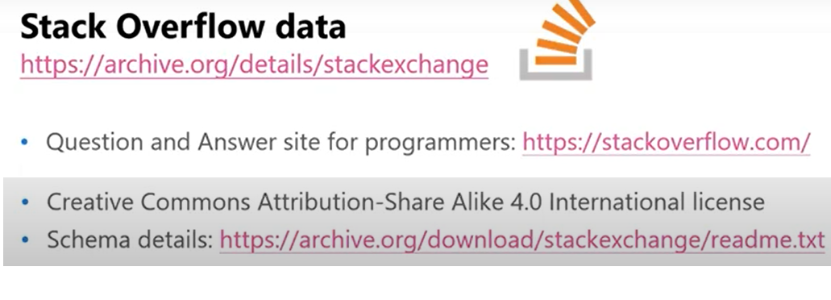

Slide 56
https://archive.org/download/stackexchange https://www.brentozar.com/archive/2015/10/how-to-download-the-stack-overflow-database-via-bittorrent/

Slide 57
https://meta.stackexchange.com/questions/9134/jon-skeet-facts

Slide 58
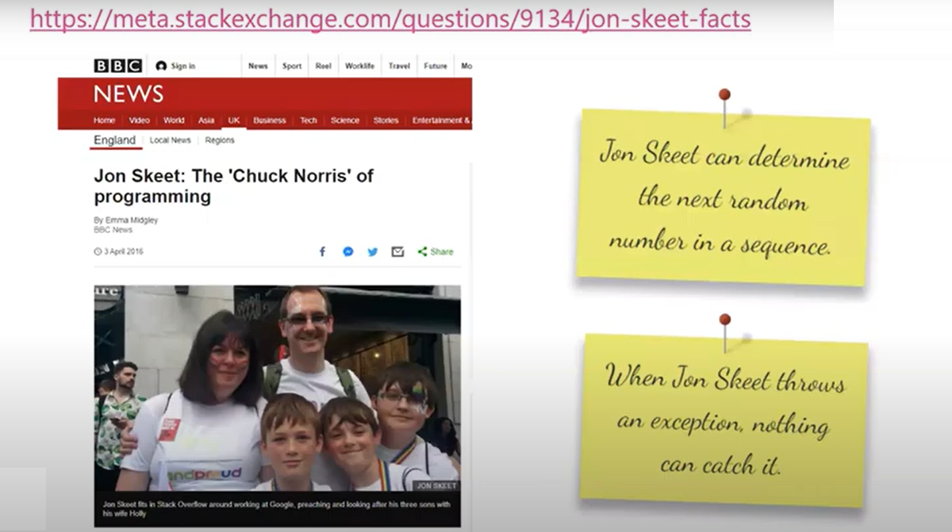

Slide 59
http://askjonskeet.com/

Slide 60
Term Queries
It is used to returns documents that contain an exact term in a provided field.
Avoid using term queries with text fields
This is because term queries don't analyze data at the time of querying.
Better for types keyword,numeric,boolean,date

Slide 61
Term
Get /stackoverflow/_search
{
"query":
{
"match": {
"parentid": "1240805"
}
}
}

Slide 62
Fuzzy
Get stackoverflow/_search
{
"query":
{
"fuzzy": {
"lasteditordisplayname": {
"value": "uses151323",
"fuzziness":1
}
}
}
} Sql Equivalent for fuzzy query https://www.got-it.ai/solutions/sqlquerychat/sql-help/data-query/sql-fuzzy-logic-matching-step-by-step-example-in-sql-server/

Slide 63
Prefix
Get stackoverflow/_search
{
"query":
{
"prefix": {
"lasteditordisplayname": {
"value": "user151"
}
}
}
}

Slide 64
RegularExpression Query
Get stackoverflow/_search
{
"query":
{
"regexp": {
"lasteditordisplayname": {
"value": "user[0-9]+3"
}
}
}
}

Slide 65
Terms
If we want to pass an array and search. Equivalent of In clause in SQL Get /stackoverflow/_search
{
"query":
{
"terms": {
"parentid": ["1240805","1240718"]
}
}
}

Slide 66
Range queries
Get /stackoverflow/_search
{
"query":
{
"range": {
"creationdate":
{
"gte": "2009-08-06 00:00:00",
"lte": "2009-09-06 00:00:00",
"format": "yyyy-MM-dd HH:mm:ss"
}
}
}
}

Slide 67
Exists
Exists query is used to get fields that have value other than null and also field exists
Get stackoverflow/_search
{
"query":
{
"exists": {
"field": "closeddate"
}
}
}

Slide 68
WildCard
Get stackoverflow/_search
{
"query":
{
"wildcard": {
"lasteditordisplayname": {
"value": "us*3"
}
}
}
} select top 10 * from Posts where lasteditordisplayname like 'use%%1'

Slide 69
FULL TEXT QUERIES
These are the queries which can be used on analyzed text fields.

Slide 70
Match Queries

Slide 71
Questions answered by JonSkeet Get stackoverflow/_search{ "query": { "match": { "owneruserid": "22656" } }}

Slide 72
Get stackoverflow/_search
{
"query":
{
"match": {
"title": "pavan python"
}
}
}

Slide 73
Operator in Match
Get stackoverflow/_search
{
"query":
{
"match": {
"title":
{
"query": "java python",
"operator": "and"
}
}
}
}

Slide 74
Fuzziness
Get stackoverflow/_search
{
"query":
{
"match": {
"title":
{
"query": "bava python",
"fuzziness": 1,
"operator": "and"
}
}
}
}

Slide 75
Match Phrase
The match_phrase query analyzes the text and creates a phrase query out of the analyzed text.
Returns documents that contain the words of a provided text, in the same order as provided. The last term of the provided text is treated as a prefix, matching any words that begin with that term. GET /stackoverflow/_search
{
"query": {
"match_phrase": {
"body": "This should do"
}
}
}

Slide 76
Match Phrase with Slop
GET /stackoverflow/_search
{
"query": {
"match_phrase": {
"body":
{
"query": "this can should do",
"slop": 1
}
}
}
}

Slide 77
Multi Match
GET /stackoverflow/_search
{
"query": {
"multi_match": {
"query": "solve ldap",
"fields": ["title","body"],
"operator": "and"
}
}
}

Slide 78
Get All questions/ans by Jon Skeet and has Tags
Get stackoverflow/_search{ "query": { "bool": { "must": [ { "match": { "owneruserid": "22656" } }, { "exists": { "field": "tags" } } ] } }} select * from Posts where owneruserid=22656 and Tags is not null

Slide 79
Bool Queries
A query that matches documents matching boolean combinations of other queries. The bool query maps to Lucene BooleanQuery. It is built using one or more boolean clauses, each clause with a typed occurrence. The occurrence types are: Must, Must_Not,Filter,Should

Slide 80
Range queries
To find all posts between dates Get stackoverflow/_search{ "query": { "range": { "creationdate": { "gte": "2008-01-01T14:39:30.143Z", "lte": "2020-01-01T14:39:30.143Z" } } }}

Slide 81
Selecting Specific fields
Get stackoverflow/_search{ "query": { "match": { "tags": "python" } }, "_source":["commentcount"]}

Slide 82
Analyzers
POST _analyze { "analyzer": "whitespace", "text": "The quick brown fox." } POST _analyze { "tokenizer": "standard", "filter": [ "lowercase", "asciifolding" ], "text": "Is this déja vu?" }

Slide 83
Analyze API
Get /_analyze{ "text":"<python><python-2.6><python-datamodel>"} GET /_analyze{ "tokenizer" : "keyword", "filter" : ["lowercase"], "char_filter" : ["html_strip"], "text" : "aa <python><python-2.6><python-datamodel>"}

